Slide 1



Trusted sla-guided data integration on multi-cloud environments
Daniel Aguiar da Silva Carvalho, Magellan, IAE, Université Jean Moulin Lyon3
Advisors
Chirine Ghedira Guegan, Magellan, IAE, Université Jean Moulin Lyon3, France
Genoveva Vargas-Solar, CNRS, LIG-LAFMIA, France
Nadia Bennani, CNRS INSA-Lyon, LIRIS, UMR5205 - France

Slide 2
Agenda

Slide 3
Methodology
Regular meetings with the advisors
Easy access to the advisors (mail, skype and face-to-face meetings)
Objective: show progress, discuss technical and scientific issues, and formalization exercises
At least one time in a week
Regular presentations inside the research team (Magellan) and also in an external team (LIRIS)
Preparing experimentation environments and learning new technology

Slide 4
Professional and scientific aspects
Attended courses
Scientific production
Other dissemination activities

Slide 5
Professional and scientific aspects
Attended courses
Code | Course | Hours | Year
E1a | Français pour non francophones niveau 1 beginner | 39h | 2014
E1a | Français pour non francophones niveau 1 beginner/débutant, élémentaire | 39h | 2015
E1b | Français pour non francophones niveau 2 intermé- diaire | 39h | 2015
E7 | Writing a scientific paper step by step | 20h | 2015
E1a | E1a Français langue étrangère-niveaux débutant à élémentaire - French as a Foreign language-beginner to elementary levels | 39h | 2016

Slide 6
Professional and scientific aspects
Scientific production
D. A. S. Carvalho, Nadia Bennani, Genoveva Vargas-Solar, Chirine Ghedira, Placido Souza Neto. Can Data Integration Quality be Enhanced on Multicloud using SLA?. DEXA 2015, Sep 2015, Valencia, Spain. Lecture Notes in Computer Science 9262, Springer 2015, pp. 145-152.
M. A. Macedo, D. A. S. Carvalho, M. A. Musicante, A. Pardo and U. S. Costa. An abstract machine for integrating heterogeneous web applications, 2015 IEEE/ACS 12th International Conference of Computer Systems and Applications (AICCSA), Marrakech, 2015, pp. 1-8.
D. A. S. Carvalho, P. A. Souza Neto, G. Vargas-Solar, N. Bennani, C. Ghedira. Rhone: a quality-based query rewriting algorithm for data integration, Short paper, 20th East-European Conference on Advances in Databases and Information Systems, ADBIS 2016, pp. 80-87.
D. A. S. Carvalho, P. A. Souza Neto, G. Vargas-Solar, N. Bennani, C. Ghedira. Towards Quality Guided Data Integration on Multi-Cloud Settings, ServiceOriented Computing - 14th International Conference, ICSOC 2016, PhD Symposium, Banff, AB, Canada, October 10-13, 2016.

Slide 7
Professional and scientific aspects
Other dissemination activities
Thematic school: 1st French Brazilian School on Smart cities and Big Data
Conference as author: paper presentation: « Rhone: a quality-based query rewriting algorithm for data integration » at ADBIS 2016
Presentation in the Magellan
Paper proposal presentation. « Trusted SLA-Guided Data Integration on Multi-cloud Environments »
Query rewriting algorithm and ongoing works presentation. « A Service-based Query Rewriting Algorithm »
External presentation
PhD proposal and query rewriting algorithm presentation. « Trusted SLA-Guided Data Integration on Multi-cloud Environments »
Seminar concerning the paper accepted to the ADBIS 2016. « Rhone: a quality based query rewriting algorithm for data integration »

Slide 8
Professional and scientific aspects
Other dissemination activities
Presentation in ARC 6 scientific manifestation:
Poster presentation. SLA-Guided Data Integration on Multi-cloud Environments. Poster presented in the « Journée Scientifique de l’Arc 6 » held in 20th November 2015 at Grenoble, France.
Poster presentation. SLA-Guided Data Integration on Multi-cloud Environments. Poster presented in the « Journée Scientifique de l’Arc 6 » held in 24th November 2016 at Lyon, France.

Slide 9
Data integration: existing work
Query
Result
Data integration: the teenage years. Halevy, A., Rajaraman, A., & Ordille, J. (VLDB 2006, September)
Schema integration: Past, present, and future (Ram, S., & Ramesh, V. 1999)
Global schema
Mediator
Query rewriting
Data integration architectures:
Multi-databases, federations, DW, …
(Domenig & Dittrich 1999 Sigmod Record)
MiniCon algorithm for query rewriting (Pottinger and Halevy, 2001)
Exported schemata
Data
source A
Data
source B
Data
source C
Heterogeneous data sources known in advance

Slide 10
Data integration: existing work
Services lookup and matching
[1] Paolucci, M., Kawamura, T., Payne, T. R., & Sycara, K. (2002, June). Semantic matching of web services capabilities. In International Semantic Web Conference (pp. 333-347). Springer Berlin Heidelberg.
[2} Bramantoro, A., Krishnaswamy, S., & Indrawan, M. (2005, November). A semantic distance measure for matching web services. In International Conference on Web Information Systems Engineering (pp. 217-226). Springer Berlin Heidelberg.
[3} APA Maximilien, E. M., & Singh, M. P. (2004, November). Toward autonomic web services trust and selection. In Proceedings of the 2nd international conference on Service oriented computing (pp. 212-221). ACM.
Query
Result
Mediator
Query rewriting techniques adapted to service composition
Exported API
[4] Barhamgi, M., Benslimane, D., and Medjahed, B. (2010). A query rewriting approach for web service composition. IEEE T. Services Computing, 3(3):206–222.
[5] da Costa, U. S., Alves, M. H. F., Musicante, M. A., and Robert, S. (2013). Automatic refinement of service compositions. In Daniel, F., Dolog, P., and Li, Q., editors, ICWE, volume 7977 of Lecture Notes in Computer Science, pages 400–407. Springer.
[6] Zhao, W., Liu, C., and Chen, J. (2011). Automatic composition of information-providing web services based on query rewriting. Science China Information Sciences, pages 1–17.
. . .
Distributed data services

Slide 11
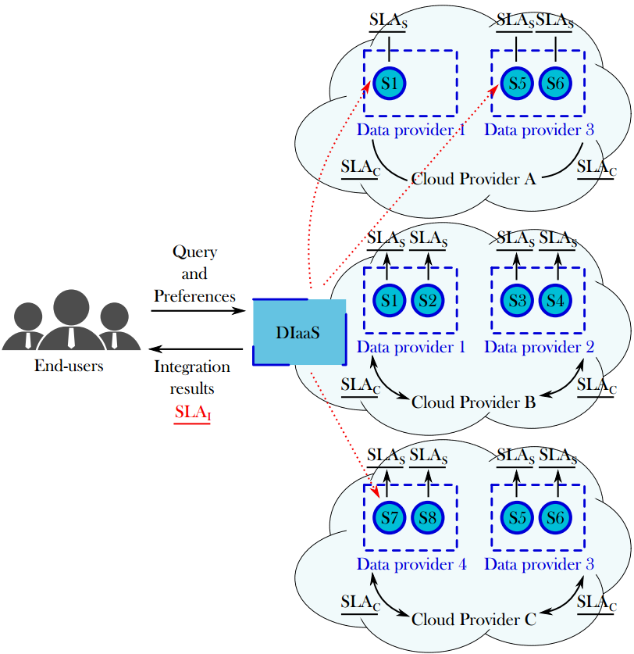
Challenges
Which services should I select ? Are the requirements being respected?
How to be sure that all SLAs are being respected?
How to integrate different SLAs associated to services involved with user’s requirements?
How results can be reused for a next query?
Objective
Propose a data integration solution in a multi-cloud environment guided by user requirements and SLA exported by different clouds

Slide 12
Results and contributions
Approach: Address data integration considering data quality (freshness, provenance, cost, availability) properties & service level agreements (SLA)
Hypothesis:
The data integration process is totally or partially externalized on different clouds that provide necessary resources under different conditions (SLA)
Data can be retrieved from several data providers (i.e., services) with different quality properties

Slide 13
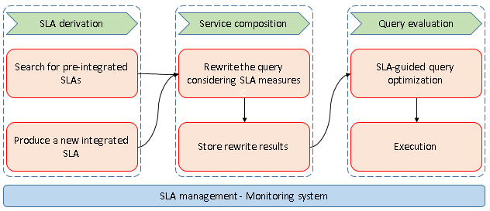
Results and contributions
Approach: Address data integration considering data quality (freshness, provenance, cost, availability) properties & service level agreements (SLA)

Slide 14
Results and contributions
Rhone query rewriting algorithm¹ for data integration which considers user integration preferences and services’ quality aspects expressed in SLAs.
Selecting candidate concrete services
Creating candidate service descriptions (CSD)
Combinig CSDs
Producing rewritings
¹ D. A. S. Carvalho, P. A. S. Neto, C. Ghedira, G. Vargas-Solar, N. Bennani. Rhone: a quality-based query rewriting algorithm for data integration. East-European Conference on Advances in Databases and Information Systems, Aug 2016, Prague, France. ADBIS East-European Conference on Advances in Databases and Information Systems, 2016.

Slide 15
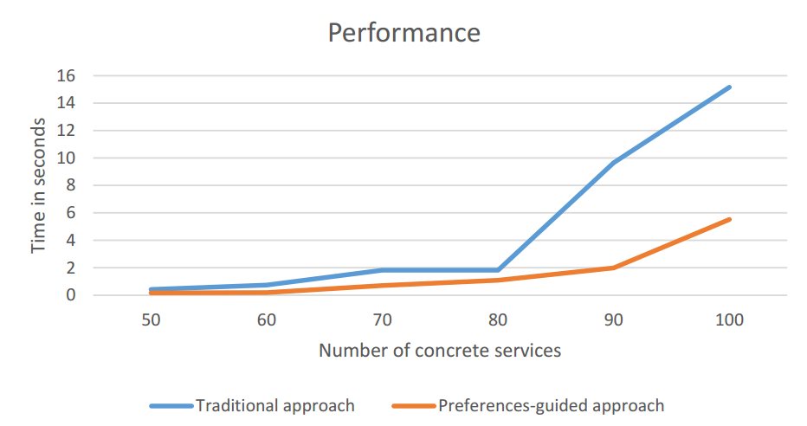
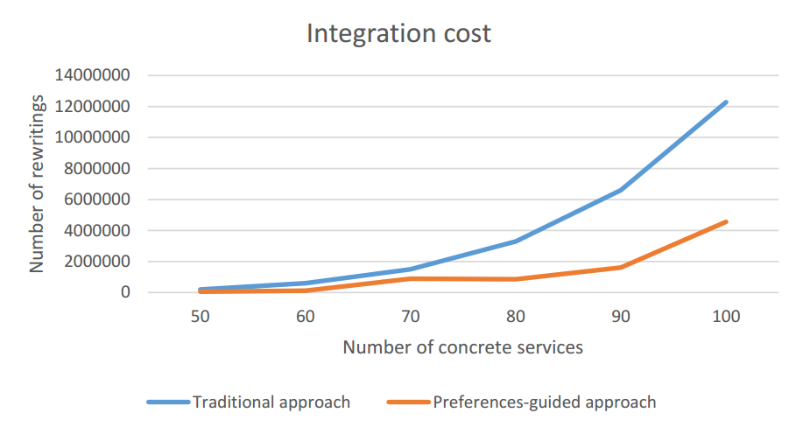
Results and contributions
Rhone query rewriting algorithm implementation and evaluation:
Cloud simulation including 100 services
Expensive while combining services: O(n^{k})
Performance increased reducing the number of rewriting solutions and integration execution time
Integration economic cost potentially reduced
Notes:
Based on the experimental validation, we can show you the Rhones’ profile
We can see the complexity of the different phases. As in the other algorithms, the most expensive step is the combination. It depends on the size of the query and the number of concrete service that could be mapped to the query.
The results of our experimental validation are illustrated by these two charts.
The performance increased by reducing the number of rewriting solutions and integration execution time. As we can see in the chart on the left.
Rewritring solutions quality enhanced and the integration economic cost is reduced once only rewriting that satisfies the user preferences are produced. As we can see in the chart on the right.
Click

Slide 16
Results and contributions
Data integration metamodel¹ and SLA schemas:
Design of a metamodel for data integration
Design of a cloud SLA (that is an agreement between a data service and a cloud provider) and a service SLA (that is a new kind of agreement defined by data services exposing the properties of the data they provide)
A method for service and composition selection:
We have started working on an heuristic to rank data services and compositions based on SLA measures concerning service properties (percentage of availability, response time, throughput and others) and data properties (data type, freshness, veracity, provenance and others).
¹ D. A. S. Carvalho, P. A. S. Neto, C. Ghedira, G. Vargas-Solar, N. Bennani. Towards Quality Guided Data Integration on Multi-Cloud Settings. 14th international conference on service oriented computing (ICSOC), Oct 2016, Banff, Alberta, Canada.
Notes:
Based on the experimental validation, we can show you the Rhones’ profile
We can see the complexity of the different phases. As in the other algorithms, the most expensive step is the combination. It depends on the size of the query and the number of concrete service that could be mapped to the query.
The results of our experimental validation are illustrated by these two charts.
The performance increased by reducing the number of rewriting solutions and integration execution time. As we can see in the chart on the left.
Rewritring solutions quality enhanced and the integration economic cost is reduced once only rewriting that satisfies the user preferences are produced. As we can see in the chart on the right.
Click

Slide 17
Results and contributions
Definition and formalization of a taxonomy of queries:
We have defined and formalized a set of possible relations between queries which differ in terms of abstract services, service properties and data properties.
A method for reusing queries:
Based on the proposed query taxonomy, we have designed and formalized a reusability approach which allows to reuse data services and compositions from previous integration in order to profit from them.
Query history data model and implementation:
Design and implementation of the query history data model, which includes queries, abstract services, data services and compositions
Rhone algorithm was adapted to be in accordance with the model
¹ D. A. S. Carvalho, P. A. S. Neto, C. Ghedira, G. Vargas-Solar, N. Bennani. Towards Quality Guided Data Integration on Multi-Cloud Settings. 14th international conference on service oriented computing (ICSOC), Oct 2016, Banff, Alberta, Canada.
Notes:
Based on the experimental validation, we can show you the Rhones’ profile
We can see the complexity of the different phases. As in the other algorithms, the most expensive step is the combination. It depends on the size of the query and the number of concrete service that could be mapped to the query.
The results of our experimental validation are illustrated by these two charts.
The performance increased by reducing the number of rewriting solutions and integration execution time. As we can see in the chart on the left.
Rewritring solutions quality enhanced and the integration economic cost is reduced once only rewriting that satisfies the user preferences are produced. As we can see in the chart on the right.
Click

Slide 18
Perspectives
Algorithms for the reusability functions
Building the proof of concept to the approach:
The query history structure was implemented in a relational database.
The idea is to validate the algorithm and to evaluate the reusing efficiency.
This work will result in a paper to the 36th International Conference on Conceptual Modeling (ER 2017) to be submitted in 17th April 2017
Our perspective is to tackle what is remaining in the contributions while writing the final thesis document to June.

Slide 19
Daniel Aguiar da Silva Carvalho, Magellan, IAE, Université Jean Moulin Lyon3
Advisors:
Chirine Ghedira Guegan, Magellan, IAE, Université Jean Moulin Lyon3, France
Genoveva Vargas-Solar, CNRS, LIG-LAFMIA, France
Nadia Bennani, CNRS INSA-Lyon, LIRIS, UMR5205 - France

